Slide 1

DEPARTMENT OF
ARTIFICIAL INTELLIGENCE AND DATA SCIENCE
ACADEMIC YEAR 2025 - 2026
SEMESTER III
ARTIFICIAL INTELLIGENCE LABORATORY
MINI PROJECT REVIEW
<ROCK PAPER SCISSOR AI AGENT>
REGISTER NUMBER | 2117240070317
NAME | SUPRIYA .A
YEAR | ||
SECTION | F
FACULTY IN-CHARGE | Mrs. S. Divya

Slide 2
PROBLEM STATEMENT
The game Counter Four (Connect Four) is a classic two-player connection game in which players take turns dropping colored discs into a vertical grid. The objective is to form a horizontal, vertical, or diagonal line of four discs of one’s own color before the opponent does.
Developing an AI-based Counter Four system poses the challenge of making the computer capable of playing intelligently — predicting future moves, blocking the opponent, and planning winning strategies in a limited computation time.
This project aims to design and implement an artificial intelligence agent that can play Counter Four optimally using the Minimax algorithm enhanced with Alpha-Beta Pruning. The algorithm evaluates possible future moves to determine the best possible action while pruning unnecessary branches of the game tree to improve performance and reduce computation time.

Slide 3
THEORETICAL BACKGROUND
Theoretical Background
The Counter Four (Connect Four) game is a two-player strategy game where players alternately drop colored discs into a grid, aiming to form a line of four discs horizontally, vertically, or diagonally.
The project uses Artificial Intelligence (AI) techniques from Game Theory to enable the computer to make intelligent moves.
The Minimax algorithm is applied to simulate all possible moves and counter-moves, assuming both players play optimally. It helps the AI choose the best move that maximizes its winning chances while minimizing losses.
To improve efficiency, Alpha-Beta Pruning is used to skip unnecessary branches in the game tree that do not affect the final decision. This reduces computation time without changing the final outcome.

Slide 4
THEORETICAL BACKGROUND
Reasons for Selection:
Optimal Decision-Making:
The Minimax algorithm ensures the AI always selects the best possible move by considering all possible future game states.
Efficiency:
Alpha-Beta Pruning significantly reduces the number of nodes evaluated, improving the algorithm’s speed and making it suitable for real-time gameplay.
Strategic Depth:
The algorithm allows deep strategic analysis, helping the AI anticipate and counter the opponent’s moves effectively.
Simplicity and Clarity:
The logic is easy to understand, implement, and visualize — making it ideal for academic and educational use.
Consistent Performance:
It produces reliable and intelligent decisions without needing large datasets or machine learning models.

Slide 5
IMPLEMENTATION AND CODE
Link to code in Git-hub Repository
List | Git-hub Repository Links
Implementation of Code Link | Counter- four- AI/Counter- four- AI.py at main · asupriya-dotcom/Counter- four- AI
Word Document Report Link | Counter- four- AI_AI_Mini_Project_Report.docx
PPT Link | AILAB_MINI_PPT_TEMPLATE_AI^0DS.pptx

Slide 6
CODE
import random
def get_user_choice():
choices = ['rock', 'paper', 'scissors']
user_input = input("Enter rock, paper, or scissors: ").lower()
while user_input not in choices:
print("Invalid input.")
user_input = input("Enter rock, paper, or scissors: ").lower()
return user_input
def get_computer_choice():
choices = ['rock', 'paper', 'scissors']
return random.choice(choices)
def determine_winner(user, computer):
if user == computer:
return "It's a tie!"
elif (user == 'rock' and computer == 'scissors') or \
(user == 'scissors' and computer == 'paper') or \
(user == 'paper' and computer == 'rock'):
return "You win!"
else:
return "Computer wins!"

Slide 7
CODE
def main():
print("Welcome to Rock, Paper, Scissors!")
user_choice = get_user_choice()
computer_choice = get_computer_choice()
print(f"You chose: {user_choice}")
print(f"Computer chose: {computer_choice}")
result = determine_winner(user_choice, computer_choice)
print(result)
if __name__ == "__main__":
main()

Slide 8
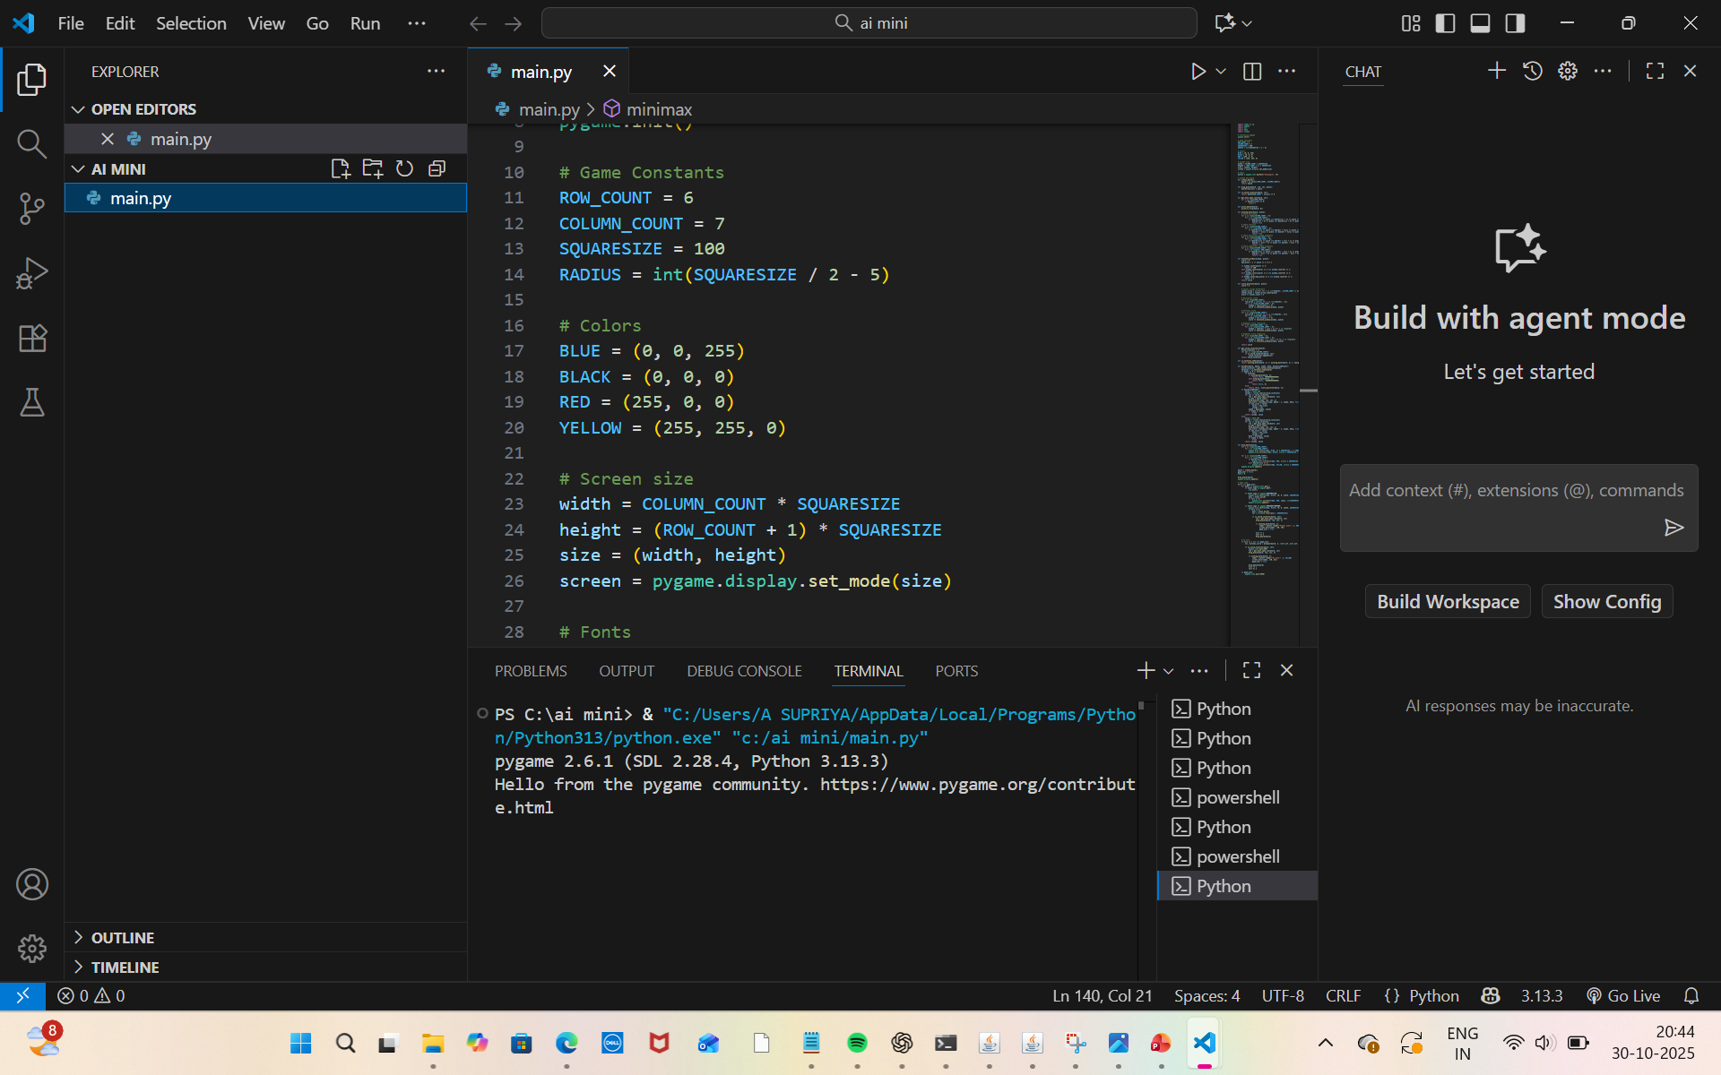
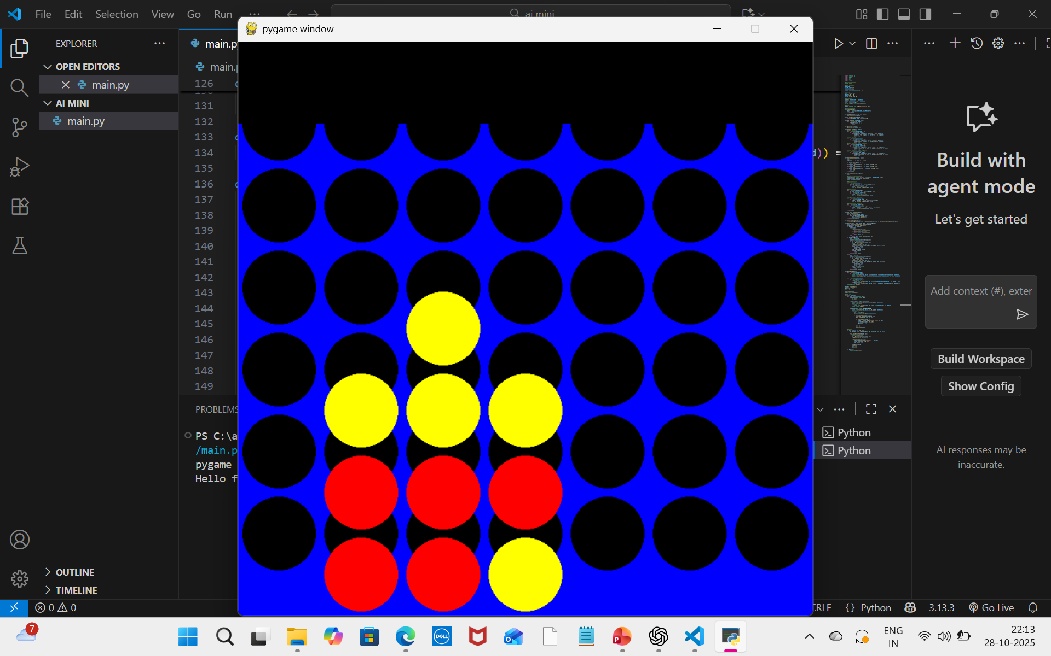
OUTPUT AND RESULTS

Slide 9
Literature survey
1. Russell & Norvig (2010) – Artificial Intelligence: A Modern Approach
This book explains the Minimax algorithm as a key AI decision-making method used in two-player games. It helps the AI choose the best possible move by predicting the opponent’s responses.
2. GeeksforGeeks – Minimax Algorithm in Game Theory
This source gives a practical explanation of how Minimax works in games. It shows examples and steps for implementing Minimax logic in programming.
3. TutorialsPoint – Alpha-Beta Pruning in AI
It explains how Alpha-Beta pruning improves Minimax by removing unnecessary paths in the search tree, making the algorithm faster and more efficient.

Slide 10
REFERENCES
Russell, S., & Norvig, P. (2010). Artificial Intelligence: A Modern Approach (3rd ed.). Prentice Hall.
GeeksforGeeks. (n.d.). Minimax Algorithm in Game Theory | Set 1 (Introduction). Retrieved from https://www.geeksforgeeks.org/minimax-algorithm-in-game-theory-set-1-introduction
TutorialsPoint. (n.d.). Alpha-Beta Pruning in Artificial Intelligence. Retrieved from https://www.tutorialspoint.com/artificial_intelligence/artificial_intelligence_alpha_beta_pruning.htm

